Slide 1

A
Presentation on
Student Mentoring App
2nd Internal Examination
Presented By:
Mr. Pritam Kumar Patel Registration No: 220720100211
Mr. Sudeep Kumar Nayak Registration No: 220720100199
Mr. A Srinibash Achary Registration No: 220720100205
Mr. Rahul Mohanty Registration No: 220720100204
November 6, 2023
DEPARTMENT OF MASTER IN COMPUTER APPLICATION(MCA)
SCHOOL OF ENGINEERING AND TECHNOLOGY, CUTM, BHUBANESWAR, ODISHA

Slide 2
Introduction
Context
Every university student faces a unique set of challenges, be it academic, personal, or administrative. We recognize the need for a comprehensive and efficient solution to address these challenges and provide students with the guidance they require
The Student Mentoring App" is designed to revolutionize the way students navigate their university journey. Our app offers a one-stop solution for managing student data and facilitating communication between students and mentors. With a user-friendly platform, it empowers students to seek guidance and solutions for their academic, personal, and administrative challenges..
DEPARTMENT OF MASTER IN COMPUTER APPLICATION
SCHOOL OF ENGINEERING AND TECHNOLOGY, CUTM, BHUBANESWAR, ODISHA
DEPARTMENT OF MASTER IN COMPUTER APPLICATION
SCHOOL OF APPLIED SCIENCES, CUTM, BHUBANESWAR, ODISHA
Solution
Presented By: Mr./Ms. Name Registration No:

Slide 3

Introduction
This Application is a cutting-edge platform designed to transform the way students experience their educational journey. In a world where students face an array of academic, personal, and administrative challenges, MentorMe steps in as the ultimate solution. This innovative app provides an all-in-one solution, seamlessly managing student data while fostering open communication between students and mentors. With a user-friendly interface, MentorMe empowers students to seek guidance and find solutions to their challenges, all within one powerful platform. It's not just an app; it's a mentor in your pocket, dedicated to making your university experience smoother and more successful.
DEPARTMENT OF MASTER IN COMPUTER APPLICATION
SCHOOL OF ENGINEERING AND TECHNOLOGY, CUTM, BHUBANESWAR, ODISHA
DEPARTMENT OF MASTER IN COMPUTER APPLICATION
SCHOOL OF APPLIED SCIENCES, CUTM, BHUBANESWAR, ODISHA
Presented By: Mr./Ms. Name Registration No:

Slide 4
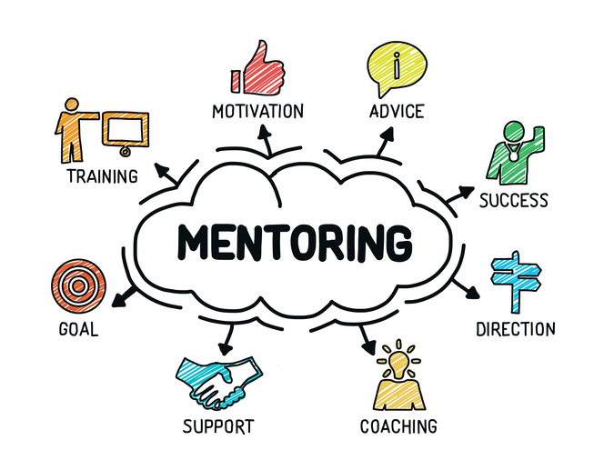
Scope
Connecting Students and Mentors: This app serves as a bridge a bridge between students seeking guidance and mentors willing to share their knowledge and expertise.
Academic Assistance: Our app offers a unique opportunity for students to seek academic support.
Career Guidance: Students can connect with mentors who have expertise in their chosen career paths, gaining invaluable advice on internships, job opportunities, and professional growth.
Personal Development: We recognize that university life is not just about academics and career aspirations. Our app also facilitates personal growth by enabling students and career aspirations.
DEPARTMENT OF MASTER IN COMPUTER APPLICATION
SCHOOL OF ENGINEERING AND TECHNOLOGY, CUTM, BHUBANESWAR, ODISHA
DEPARTMENT OF MASTER IN COMPUTER APPLICATION
SCHOOL OF APPLIED SCIENCES, CUTM, BHUBANESWAR, ODISHA
Presented By: Mr./Ms. Name Registration No:

Slide 5
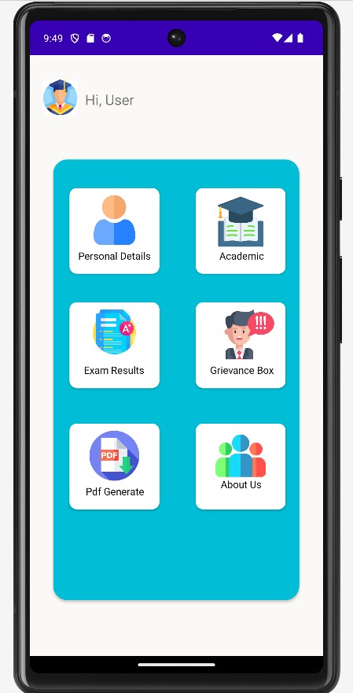
Scope
Mentorship Communities: The scope of our app extends to creating mentorship communities within our university. This not only fosters a sense of belonging but also encourages mentors to give back to the academic community.
Feedback and Improvement: The app allows students to provide feedback and rate their mentorship experiences, ensuring continuous improvement and accountability. This data will be invaluable for both students and mentors in refining their interactions.
User-Friendly Experience: Our app aims to provide seamless and intuitive user experience. With an appealing user interface, simplified navigation. And responsive design, it’s accessible to all. One of the key features of this app is its user-friendly and aesthetically pleasing user interface.
DEPARTMENT OF MASTER IN COMPUTER APPLICATION
SCHOOL OF ENGINEERING AND TECHNOLOGY, CUTM, BHUBANESWAR, ODISHA
DEPARTMENT OF MASTER IN COMPUTER APPLICATION
SCHOOL OF APPLIED SCIENCES, CUTM, BHUBANESWAR, ODISHA
Presented By: Mr./Ms. Name Registration No:

Slide 6
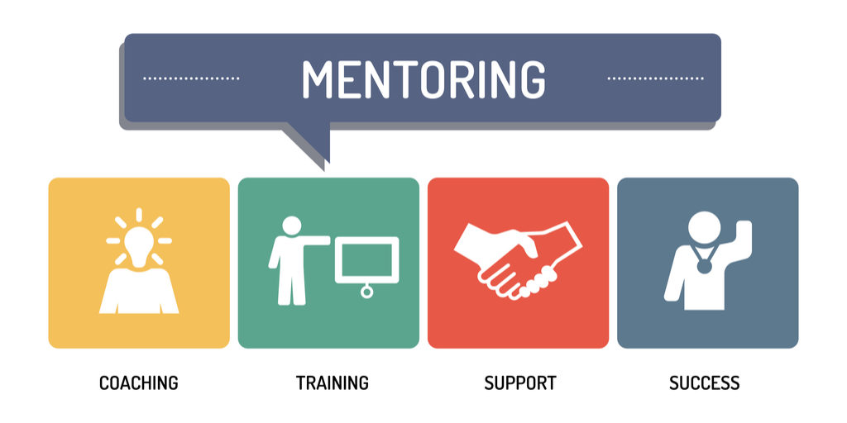
Features
This app boasts a range of features, including:
User registration and profile management
Intelligent mentor-student matching
Real-time communication tools
Problem submission and resolution tracking
A comprehensive resource center
Progress tracking and personalized recommendations
Notifications for upcoming events and deadlines
Robust reporting for administrators
DEPARTMENT OF MASTER IN COMPUTER APPLICATION
SCHOOL OF ENGINEERING AND TECHNOLOGY, CUTM, BHUBANESWAR, ODISHA
DEPARTMENT OF MASTER IN COMPUTER APPLICATION
SCHOOL OF APPLIED SCIENCES, CUTM, BHUBANESWAR, ODISHA
Presented By: Mr./Ms. Name Registration No:

Slide 7
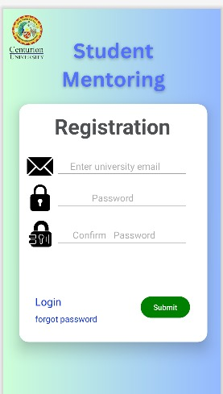
Working
Students register and create profiles with personal, academic, and extracurricular details.
A student will get to select his mentor.
Real-time communication features enable students to connect with mentors and get support.
Challenges, categorized into academic, personal, and administrative, are submitted and addressed.
A resource center provides a wealth of information and guides for students.
Progress tracking helps students set and achieve goals, all while receiving personalized recommendations.
DEPARTMENT OF MASTER IN COMPUTER APPLICATION
SCHOOL OF ENGINEERING AND TECHNOLOGY, CUTM, BHUBANESWAR, ODISHA
DEPARTMENT OF MASTER IN COMPUTER APPLICATION
SCHOOL OF APPLIED SCIENCES, CUTM, BHUBANESWAR, ODISHA
Presented By: Mr./Ms. Name Registration No:

Slide 8
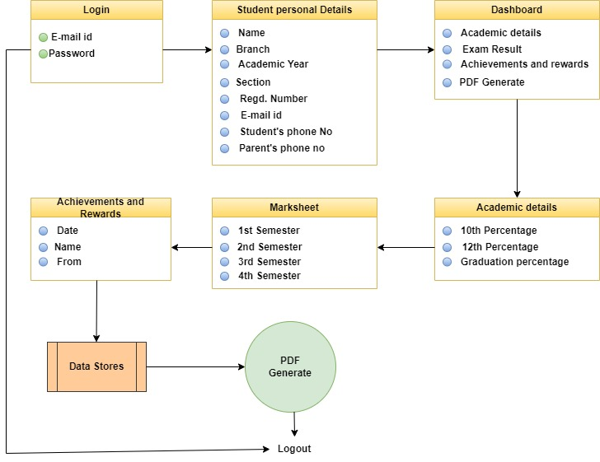
Working Flow Diagram
DEPARTMENT OF MASTER IN COMPUTER APPLICATION
SCHOOL OF ENGINEERING AND TECHNOLOGY, CUTM, BHUBANESWAR, ODISHA
DEPARTMENT OF MASTER IN COMPUTER APPLICATION
SCHOOL OF APPLIED SCIENCES, CUTM, BHUBANESWAR, ODISHA
Presented By: Mr./Ms. Name Registration No:

Slide 9
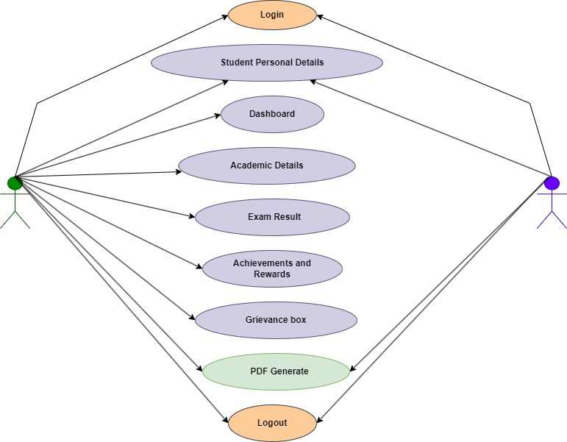
Use Case Diagram
DEPARTMENT OF MASTER IN COMPUTER APPLICATION
SCHOOL OF ENGINEERING AND TECHNOLOGY, CUTM, BHUBANESWAR, ODISHA
DEPARTMENT OF MASTER IN COMPUTER APPLICATION
SCHOOL OF APPLIED SCIENCES, CUTM, BHUBANESWAR, ODISHA
A Student and a Mentor both considered as two actors having multiple different functionalities.
8
Presented By: Mr./Ms. Name Registration No:

Slide 10
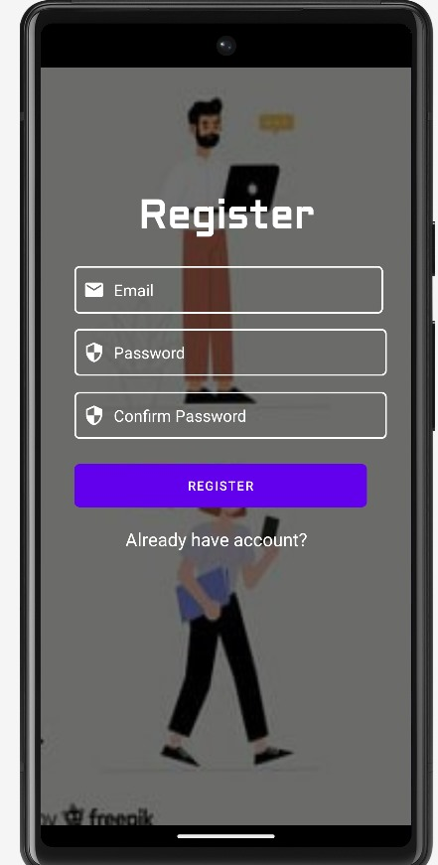
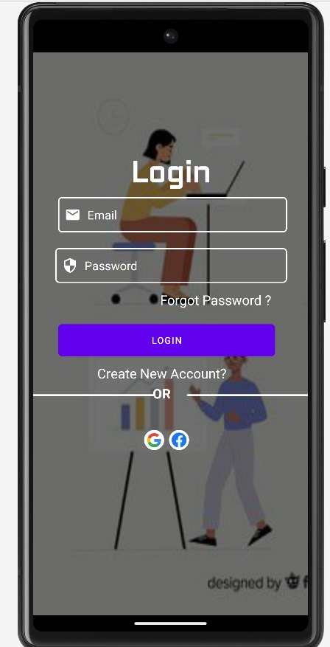
User Interface
DEPARTMENT OF MASTER IN COMPUTER APPLICATION
SCHOOL OF ENGINEERING AND TECHNOLOGY, CUTM, BHUBANESWAR, ODISHA
DEPARTMENT OF MASTER IN COMPUTER APPLICATION
SCHOOL OF APPLIED SCIENCES, CUTM, BHUBANESWAR, ODISHA
Presented By: Mr./Ms. Name Registration No:

Slide 11
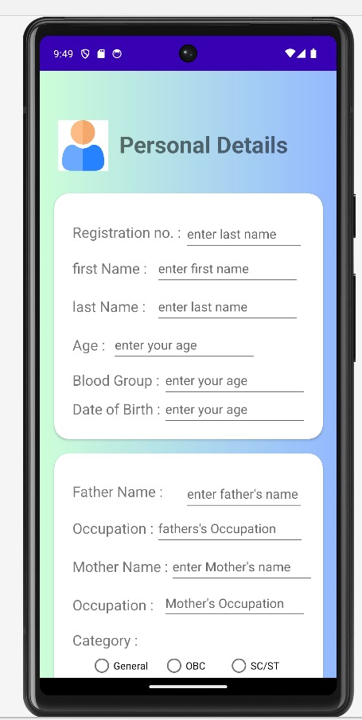
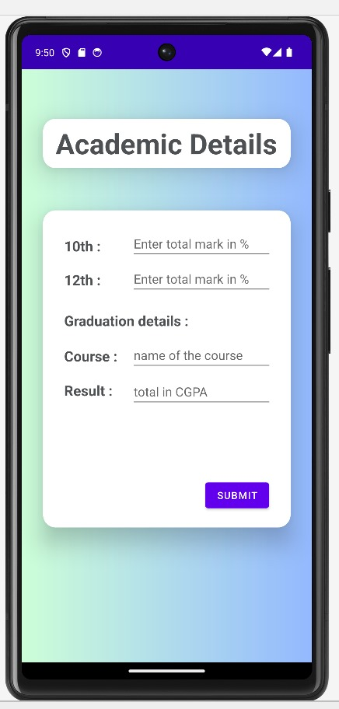
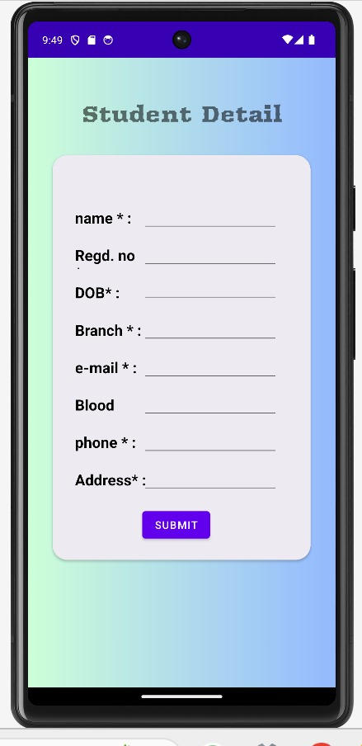
Details Page
DEPARTMENT OF MASTER IN COMPUTER APPLICATION
SCHOOL OF ENGINEERING AND TECHNOLOGY, CUTM, BHUBANESWAR, ODISHA
DEPARTMENT OF MASTER IN COMPUTER APPLICATION
SCHOOL OF APPLIED SCIENCES, CUTM, BHUBANESWAR, ODISHA
Presented By: Mr./Ms. Name Registration No:

Slide 12
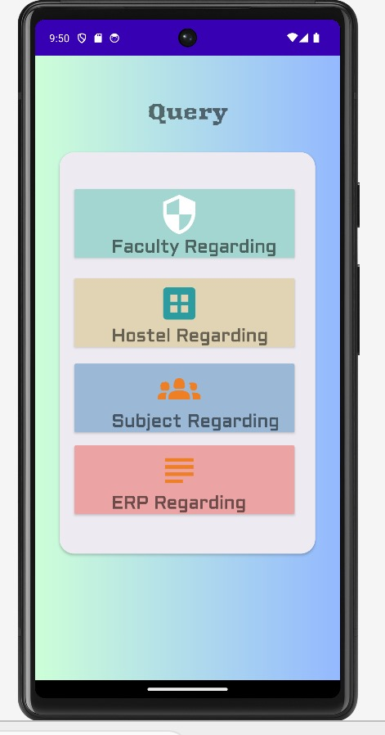
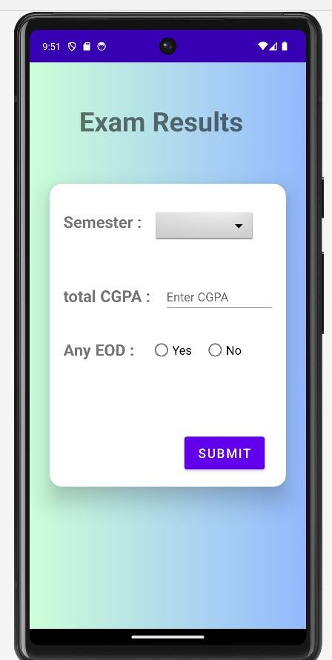
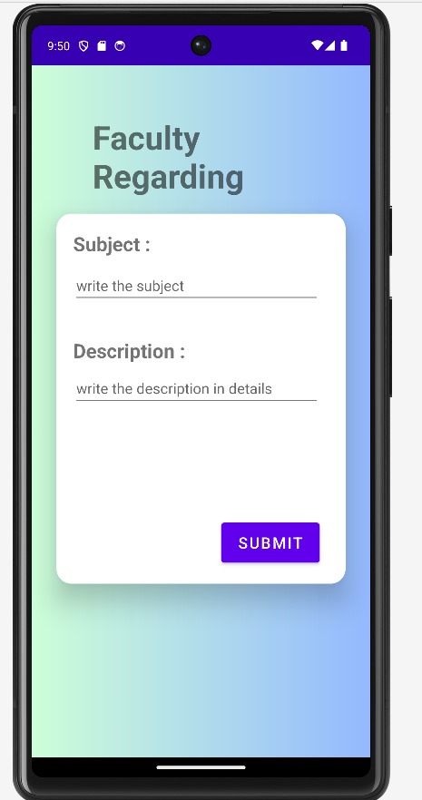
DEPARTMENT OF MASTER IN COMPUTER APPLICATION
SCHOOL OF ENGINEERING AND TECHNOLOGY, CUTM, BHUBANESWAR, ODISHA
DEPARTMENT OF MASTER IN COMPUTER APPLICATION
SCHOOL OF APPLIED SCIENCES, CUTM, BHUBANESWAR, ODISHA
Presented By: Mr./Ms. Name Registration No:

Slide 13
References
Black Book, Android Application Development – Pradeep Kothari
Geeksforgeeks
Androiddevolpers
Medium
Google for Developers
Chat Gpt
DEPARTMENT OF MASTER IN COMPUTER APPLICATION
SCHOOL OF ENGINEERING AND TECHNOLOGY, CUTM, BHUBANESWAR, ODISHA
12
Presented By: Mr./Ms. Name Registration No:

Slide 14

Any Query
DEPARTMENT OF MASTER IN COMPUTER APPLICATION(MCA)
SCHOOL OF APPLIED SCIENCES, CUTM, BHUBANESWAR, ODISHA

Slide 15

Thank you
Submitted To: Mr. Rasmi Prakash Swain.
Asst. Prof., Department of CSE, CUTM, BBSR
Group No:
Mr./Ms. Name Registration No: Email:
Mr./Ms. Name Registration No: Email:
Mr./Ms. Name Registration No: Email:
Mr./Ms. Name Registration No: Email:
Mr./Ms. Name Registration No: Email:
DEPARTMENT OF MASTER IN COMPUTER APPLICATION(MCA)
SCHOOL OF APPLIED SCIENCES, CUTM, BHUBANESWAR, ODISHA

